Slide 1
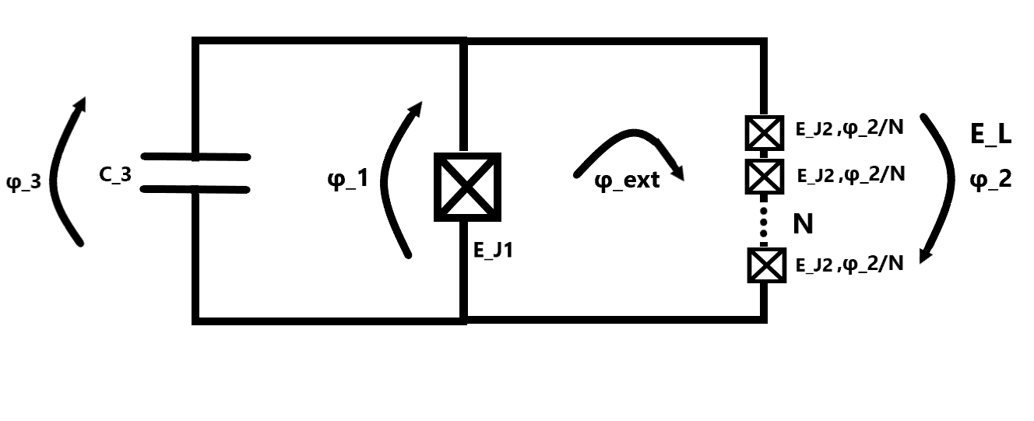
Fluxonium
2023-06-14 Group meeting
Amalie Paulsen

Slide 2
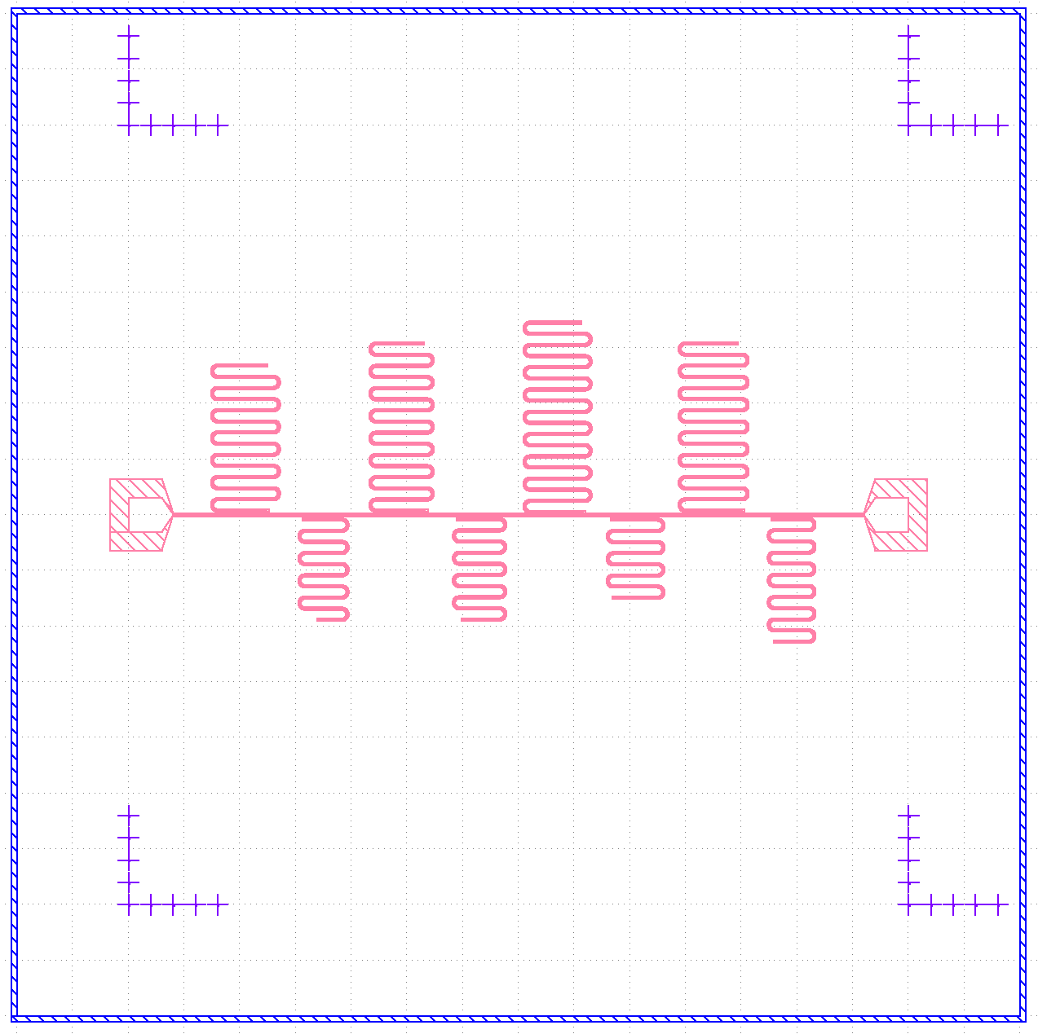
Fabrication of resonator chip5 (from MSMT)
The design
10x10 chip, 200nm Al, soft baked A4 resist, spun at 4000rpm for 1 min and baked at 115C for 2 min.
Perfect develop and etch

Slide 3

Post strip

Slide 4
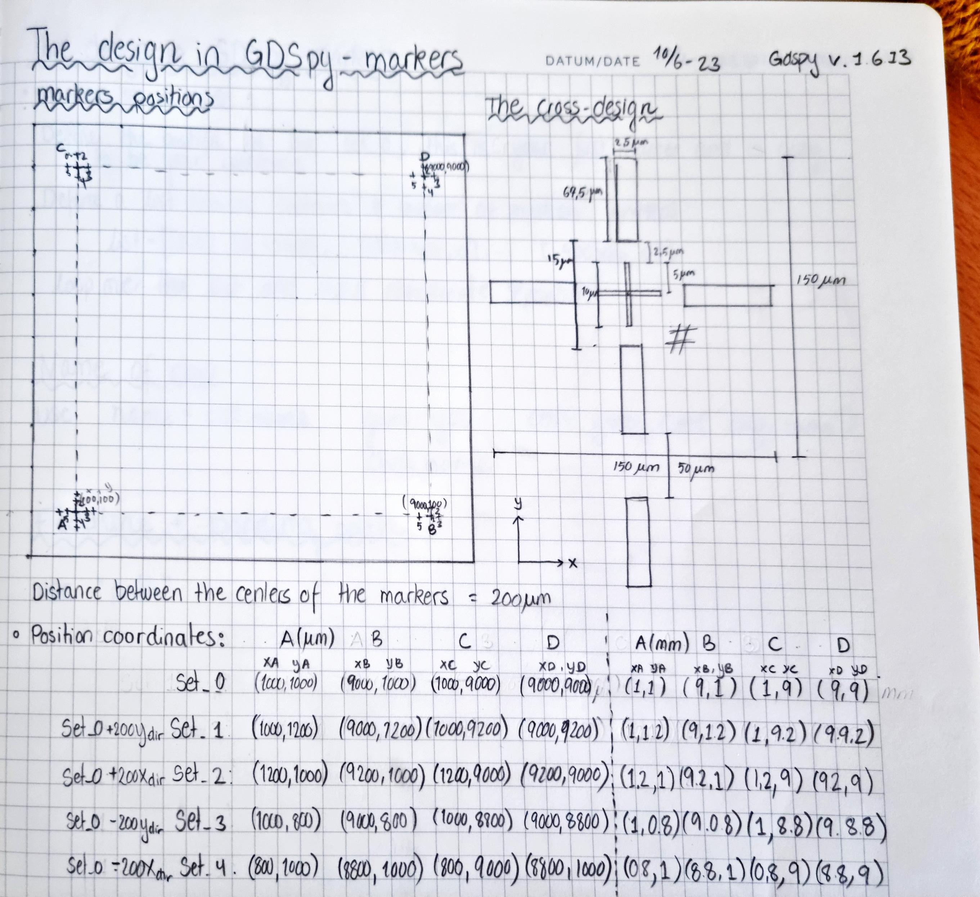
GDSpy markers

Slide 5


GDSpy markers

Slide 6
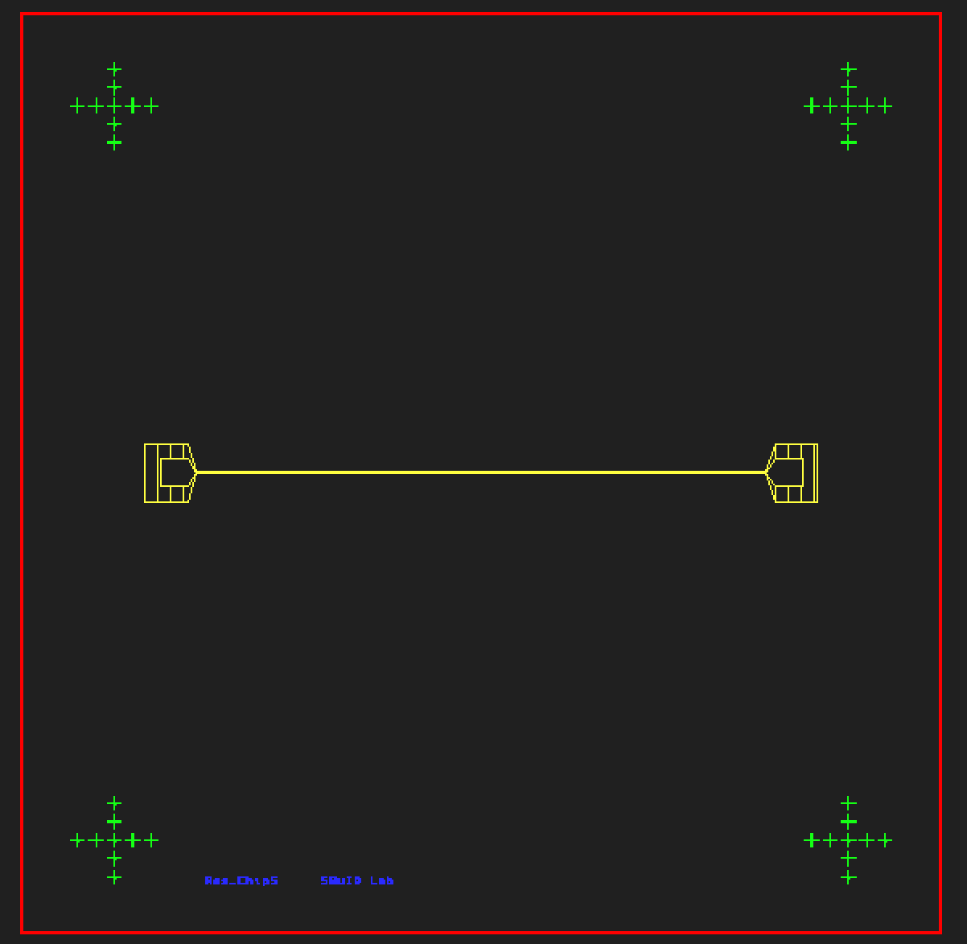

Slide 7
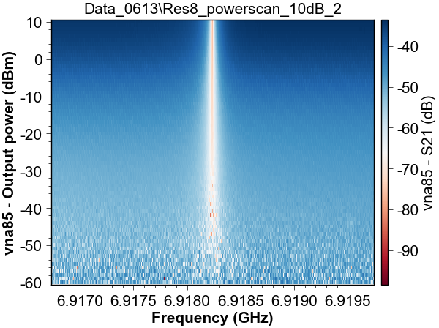
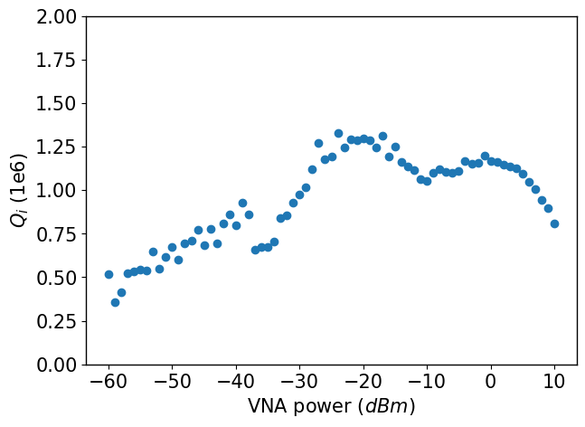
Measurements of res 8 6.918GHz

